Slide 1
Through the Internet
An animated short.
Lachlan Kermode
Advised by Arvind Narayanan.

Slide 2
”A Series of Pipes”
Senator Ted Stevens
The Internet is broadly misunderstood.
Legal consequences in a court of law.
Exploitation by hackers of users’ lack of knowledge.
Prohibits meaningful societal advance, as a fundamental component of its technological infrastructure is opaque to the majority.

Slide 3
The ‘Cloud’ Problem
The misconception that the Internet is a ’cloud’ leverages destructive neoliberal ideologies.
Oversight of the physical infrastructure that constructs the Internet, which is governed by national and state jurisdiction.
Black Transparency: The Right to Know in the Age of Mass Surveillance. Metahaven.
Signs and Machines: Capitalism and the Production of Subjectivity. Maurizio Lazzarato.
Problematics of the Internet addressed in media theory and critical discourse.

Slide 4
Internet Pedagogy
Stanford whitepaper. How Does The Internet Work?
https://web.stanford.edu/class/msande91si/www-spr04/readings/week1/InternetWhitepaper.htm
Brian Kernighan. D is for Digital: What a well-informed person should know about computers and communication.
Google. Be Internet Awesome.
https://beinternetawesome.withgoogle.com/
YouTube, video explanations
Code.org. What is the Internet. https://www.youtube.com/watch?v=Dxcc6ycZ73M
World Science Festival. There and Back Again. https://www.youtube.com/watch?v=ewrBalT_eBM
Cisco. How Does The Internet Actually Work? https://www.youtube.com/watch?v=ZonvMhT5c_Q
Andrew Blum (TED). What is the Internet Really? https://www.youtube.com/watch?v=XE_FPEFpHt4

Slide 5
Initial Ideas
Last semester; A Short History of the Web Browser.
How to shed light on the Internet for a broader audience?
Browser emulator through which to explore the development of Internet aesthetics from inception in 90s to present.
Stand-alone browser that would explain the mechanics of the Internet as it happened, built on Firefox or Chromium.
A proxy web application using a headless browser, ‘annotate’ websites to explain exactly how parts of them work.
…but would these reach a non-technical, non-critical audience?
Doubtful.
Notes:
Reconcile critical discourse with technical understanding.

Slide 6
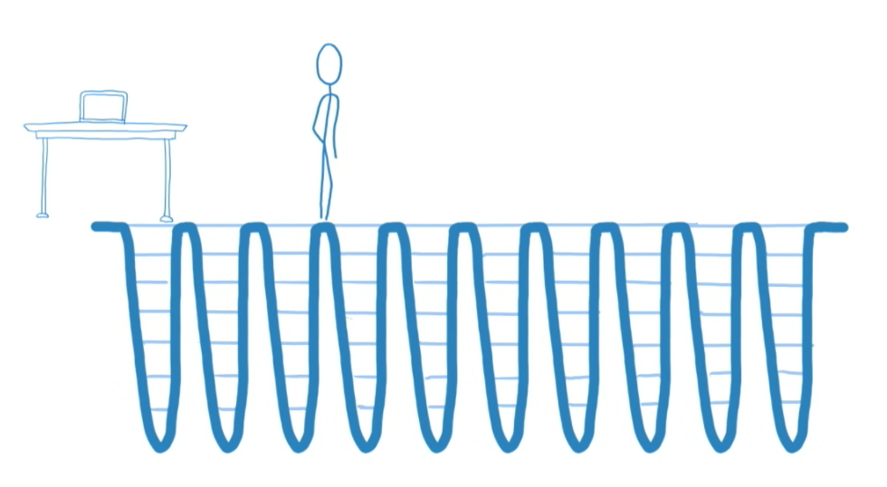
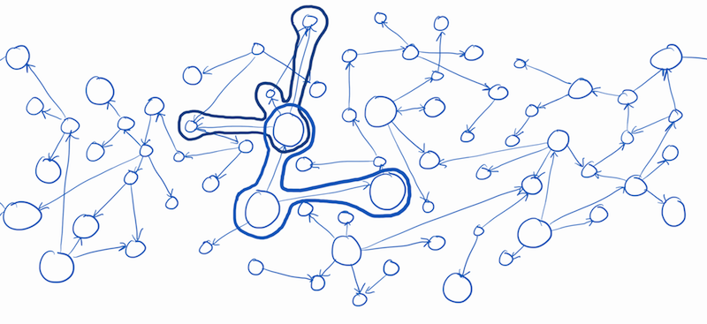
Technical Cartoons
Lin Clark, explains technical concepts in cartoon at Mozilla.
WebAssembly (an JS-alternative platform supported in browsers)
Redux, Flux (functional state management paradigms)
Relay (front-end library for interfacing with GraphQL server)
React Fiber (reconciliation algorithm for front-end framework React)
See also Julia Evans, Teaching Tech with Cartoons
Reconciliation cycle, React Fiber.
GraphQL query through Relay.

Slide 7
Animation
2-D animation widely used in video pedagogy. Words describe, animation shows in a virtual classroom.
3-D animation only in commercial operations (Disney, Pixar).
Why not 3-D?
3-D animation is hard! And time-consuming.
Pedagogues conventionally explain technical concepts, rather than framing their explanation as narrative.

Slide 8
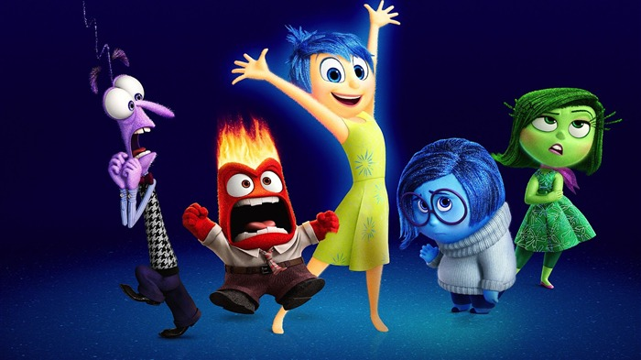
Why 3-D narrative?
Hypothesis - Internet pedagogy has failed to reach people because they find the technical language obscure.
Animated films powerfully influence younger generations, and teach them about the world through narrative.
What if there were an Inside Out whose world helped explain the Internet?
Notes:
And maybe rightfully so; computer scientists are horrible at naming.

Slide 9
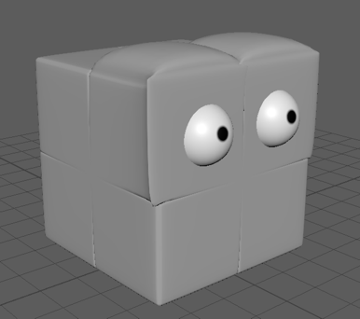
Through the Internet
A 2-5 minute 3-D animated short that tells the story of a data packet’s journey from a laptop computer to the ‘gates’ of Facebook.
Travels from Laptop to Router (WiFi).
Travels from Router to Router (Ethernet).
Travels from Router to Server (transatlantic cable, fibre optic).
Arrives at Facebook server, is checked in.

Slide 10
Design Goals
Demonstrate that:
The Internet is a physical architecture.
Data resides within national structures and is subject to physical exigencies (sub-poenas, governmental/corporate surveillance).
What we take to be ‘the Internet’ is essentially centralized, given the amount of traffic that goes through Facebook.

Slide 11
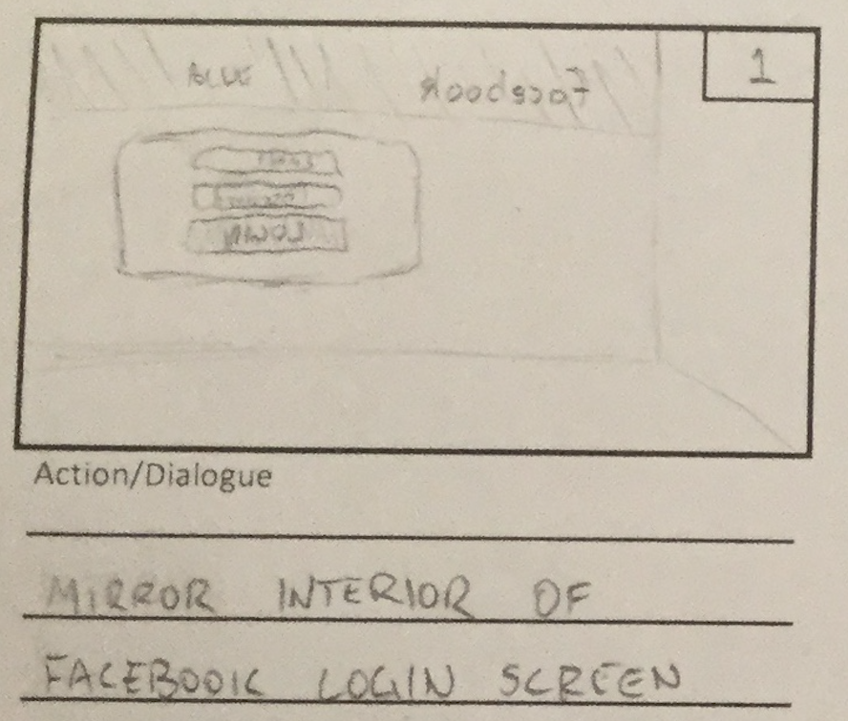
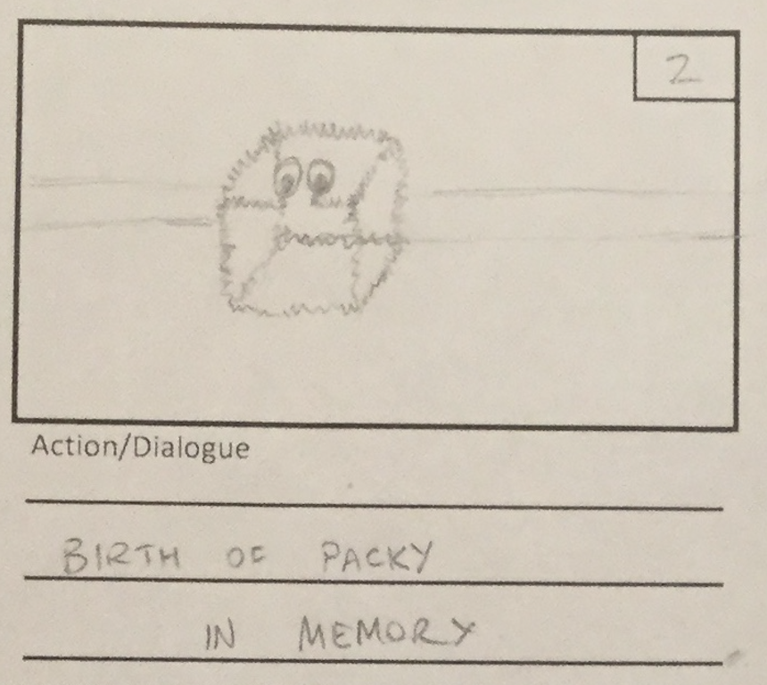
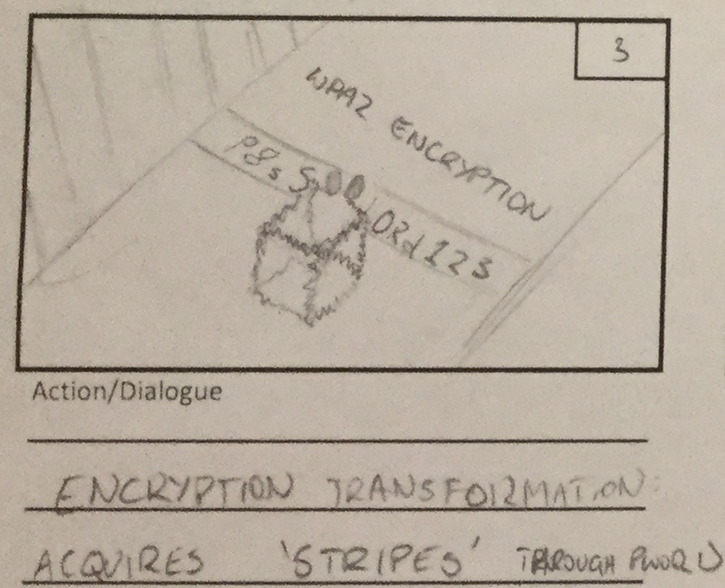
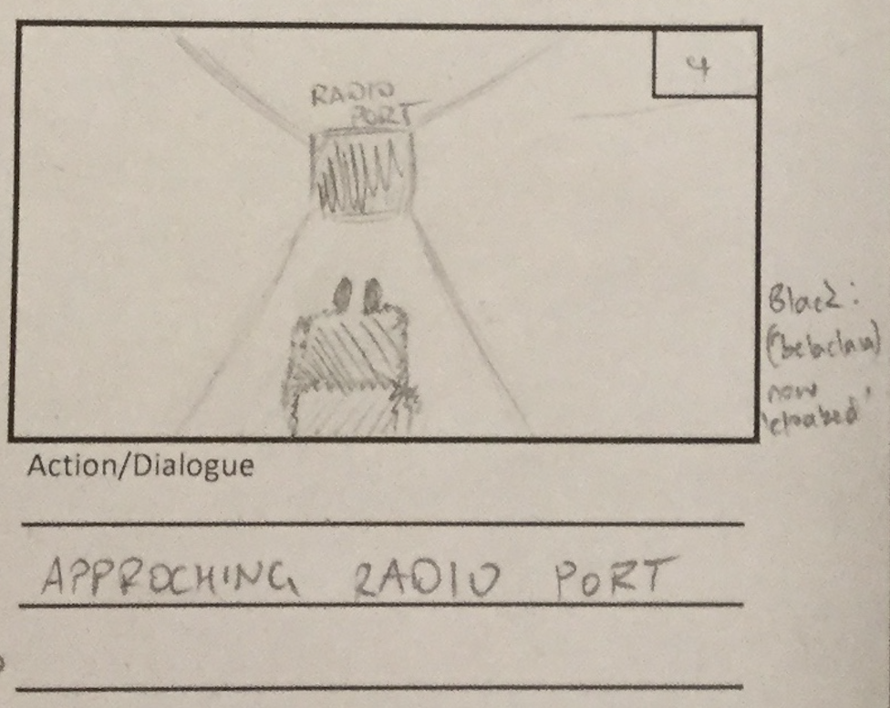
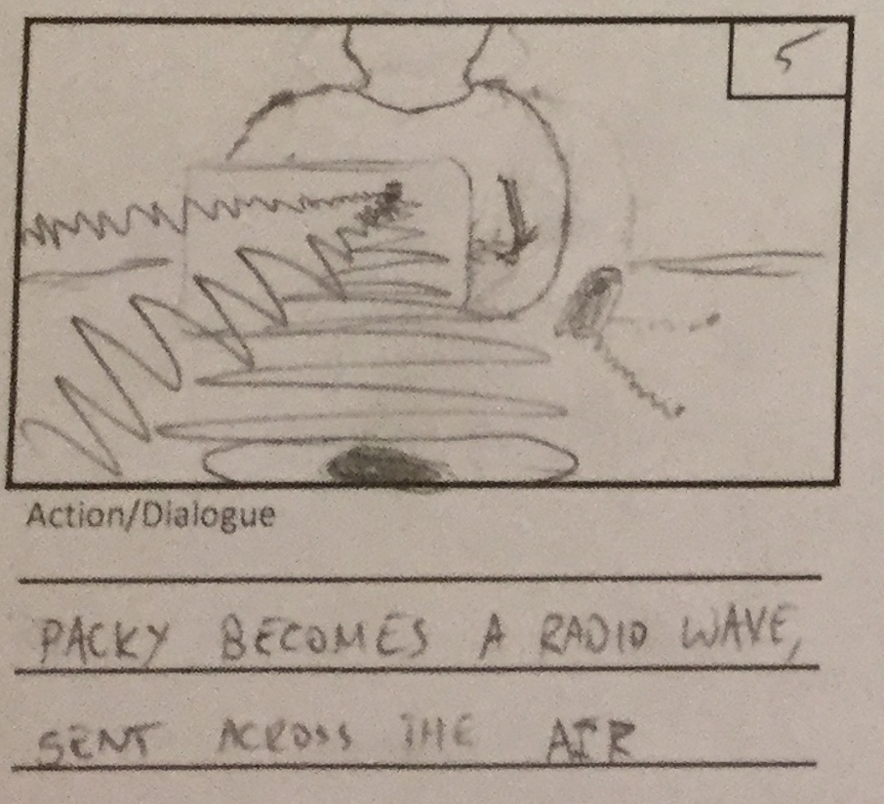
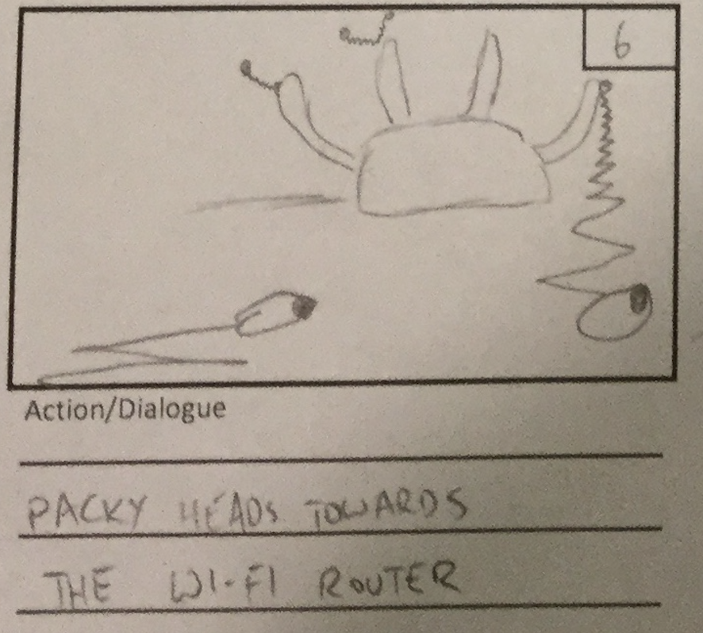
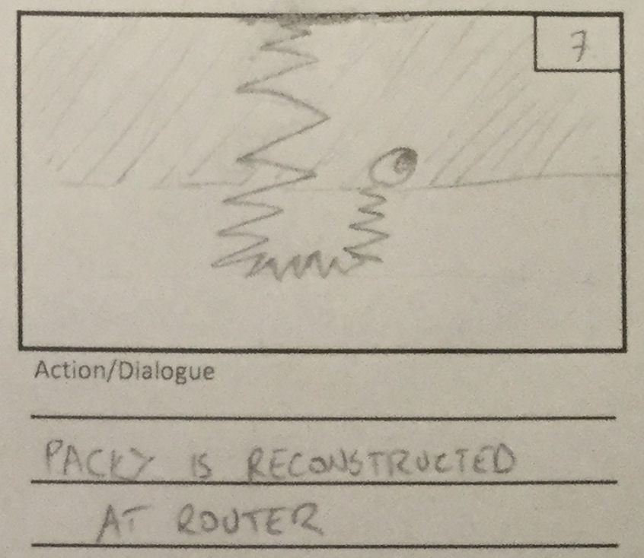
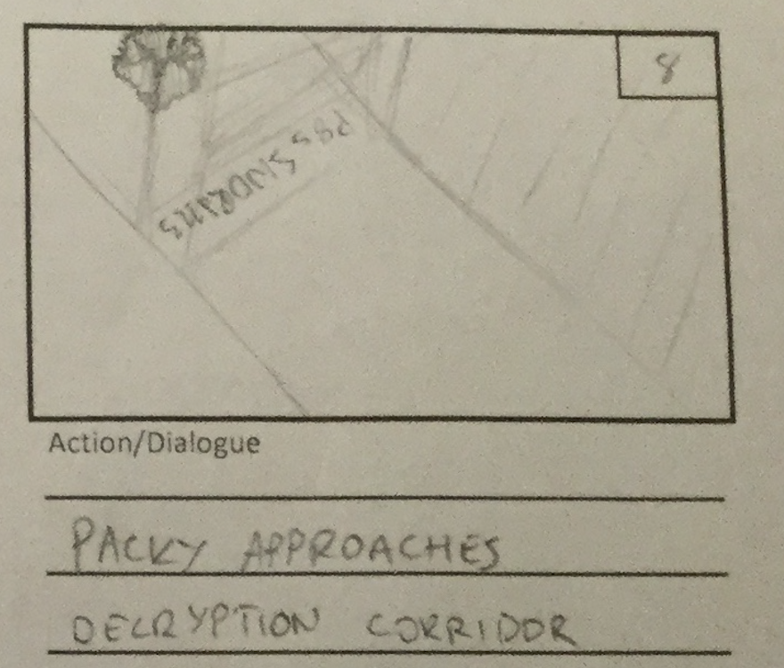
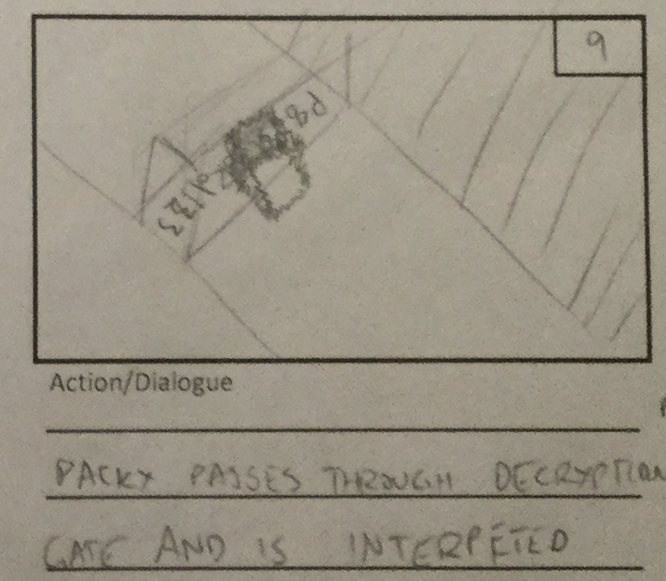
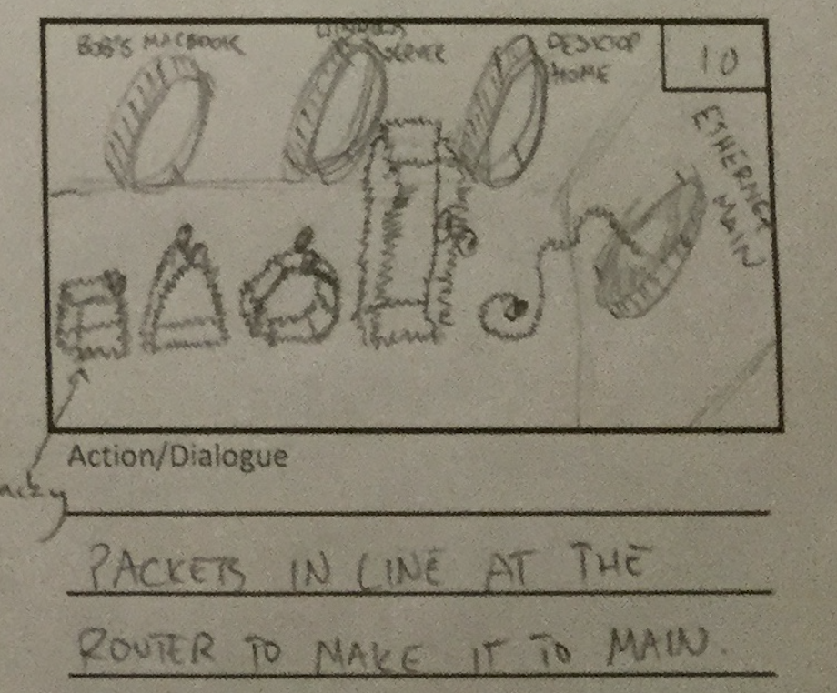
Basic Outline
Notes:
Follows with an in-flight screen description of packy’s journey across the Tamares Telecom, from Amsterdam -> London.
Then again from the far side of England across the Transatlantic cable, demonstrating an amplifier at work.
Once arrived in NJ, the packets are directed according to their headers, in which scene the proportions of traffic that go to Google, YouTube and Facebook will be shown.
Then at Facebook, a separation of packets by shape (race, gender, political preferences), channeling each to a line.
The short ends in line for an ominous looking gate, which represents the data center in the U.S, flying an American flag.

Slide 12
Stack
Autodesk Maya – ‘end to end’ software for 3-D animation.
Adobe Photoshop and InDesign – image editing suites.
Finish Your Film: Tips and Tricks for Making a Short Film in Maya, Kenny Roy.
How to Cheat in Maya: Tools and Techniques for Character Animation, Kenny Roy.
Hours and HOURS of Lynda tutorials on Maya and animation.

Slide 13
Method
Maya, Photoshop and InDesign tutorials
Storyboard
Animatic
3-D Pre-Production (modelling, rigging, textures)
3-D Production (staging scenes)
Animation
Rendering
Post-Production (final film)
Clean assets for open source.

Slide 14
Evaluation
The narrative representation of Internet architecture is faithful to technical architecture of the physical Internet.
The short is accessible and interesting to an American/British, English-speaking audience in their teens or older.
Viewers come away with a high-level understanding of the basic protocols that make up the modern Internet, such as WiFi, routing, packets, and encryption/decryption. Additionally, viewers should have improved knowledge regarding the three design goals listed in a previous slide.
Open source assets useable for proficient animators.
Assessment by Professor Narayanan.
Questionnaire filled out by non-technical viewers after watching the film.
Attempt to find capable animators to comment on assets’ usability.

Slide 15
Questions?
Lachlan Kermode
http://lachlankermode.com
Advised by Arvind Narayanan.

